Slide 1
SEOUL BIKE RENTAL
-Matt Adeola
-Sukaina Ali
-Shivali Dalmia
-Sushant Khullar

Slide 2
OVERVIEW
Introduction
Dataset Description
Data Exploration
Hypothesis Questions
Data Exploration
Data Transformation and preparation
Machine Learning models
M/L Post feature elimination
Feature extraction (PCA, Kernel PCA)
Best Fit Model
Hypothesis Results

Slide 3
INTRODUCTION
Rental bike sharing system has been introduced in many urban areas across the globe.
Improves mobility comfort.
Contributes to a greener environment.
However, it is important to have adequate number of rental bikes available as per demand.
The purpose of this study was to create an analytical model, using machine learning methods and techniques, to predict the number of bikes rented out in the city of Seoul, South Korea.
In addition, provide a deeper and more thoughtful understanding of the predicted numbers.

Slide 4
DATASET DESCRIPTION
Total instances: 8,760
Number of features: 14 features
4 categorial attributes: Hour, Seasons, Holiday, Functioning Day.
9 continuous attributes: Temperature(°C), Humidity(%), Wind speed (m/s), Visibility (10m), Dew point temperature(°C), Solar Radiation (MJ/m2), Rainfall(mm), Snowfall (cm).
Dependent attribute (target): Rented bike count.
Missing values: No missing values for continuous and categorical features.
Class Imbalance check was performed for categorical features such as Seasons, Holiday, quarters and rush hour.
Source: https://archive.ics.uci.edu/ml/datasets/Seoul+Bike+Sharing+Demand

Slide 5
HYPOTHESIS QUESTIONS
Summer season has the most bike rentals.
Rush hours has the most bikes rentals.
No Holiday days have the most bike rentals.
Number of bikes rented in each quarter.
Extreme temperature led to low bike rentals.
Rainy days with low visibility led to low bike rentals.
A snowy day with low visibility led to low least bike rentals.

Slide 6
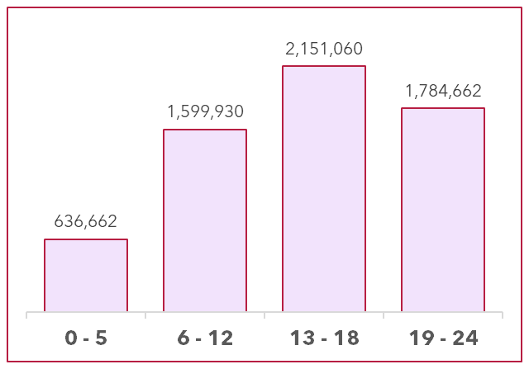
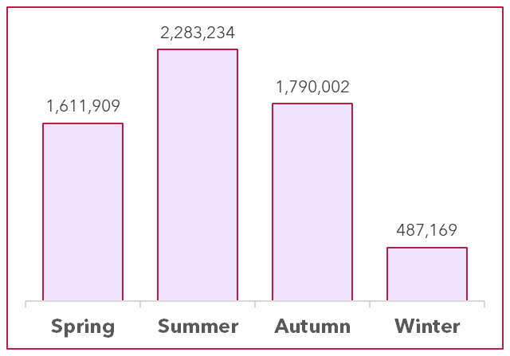
DATA EXPLORATION
SEASONS
REQUEST TIME SLOT

Slide 7
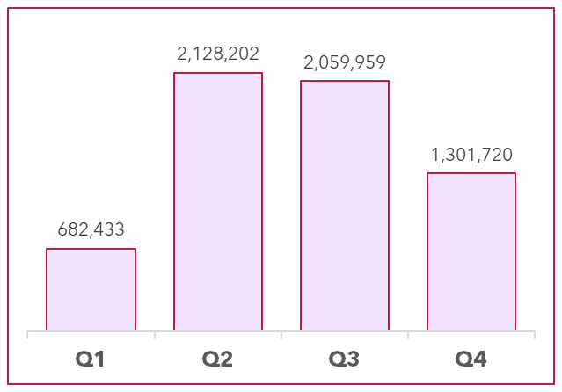
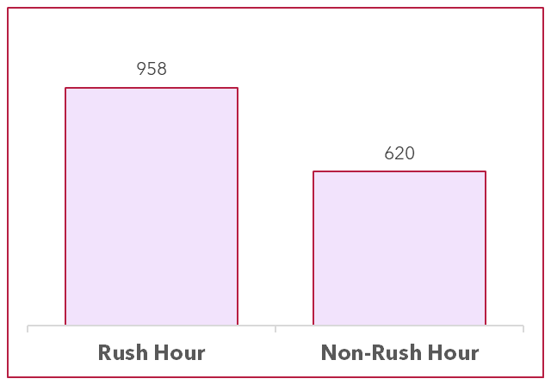
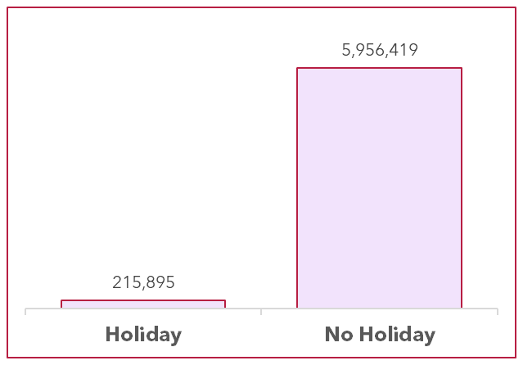
DATA EXPLORATION contd.
RUSH HOUR
HOLIDAYS
QUARTERS

Slide 8
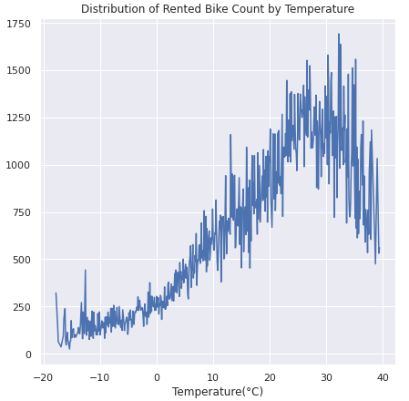
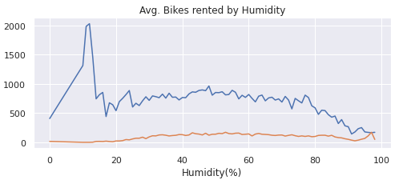
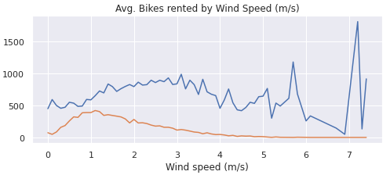
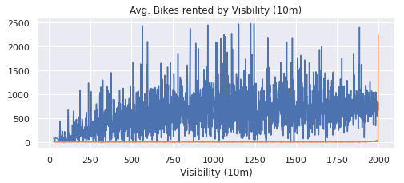
DATA EXPLORATION contd.

Slide 9
DATA TRANSFORMATION
Information gathered from data exploration phase was used to clean and transform the raw dataset.
Following new features were created using ‘Hour’ and ‘Date’ features:
“Rush Hour” – Selecting 0600hrs-0800hrs, and1700hrs-1900hrs as rush hours.
“Request Time Slot” – [6hrs-12hrs], [0hrs-5hrs] , [13hrs-18hrs], [19hrs-24hrs] .
“Quarter” – Q1 (Jan-March), Q2 (April-June), Q3 (July-Sept), Q4 (Oct-Nov).
“Hour” and “Date” variables were deleted as they had been captured in new features (e.g., Request Time Slot, Rush Hour, Quarter).
‘Holiday’ and ‘Rush Hour’ features were transformed into binary format using label encoding.

Slide 10
DATA PREPARATION
One hot encoding was performed on the categorical variables, including Seasons, Quarter, Request Time Slot using OneHotEncoding technique.
Normalized to standard scale using StandardScaler.
Train-Test split (70-20) was performed using train_test_split.

Slide 11
MODEL IMPLEMENTATION
As Rented Bike Count is a continuous variable, various regression methods like, linear regression and polynomial regression (with ridge, lasso, elastic net) are used.
Decision trees and random forests were also implemented to make predictions.
These models were trained on the transformed data set in two phases - pre and post feature elimination.
These models predicted rental bike count on test data.
Significant insights were observed between the dependent variable and other features within the dataset.

Slide 12
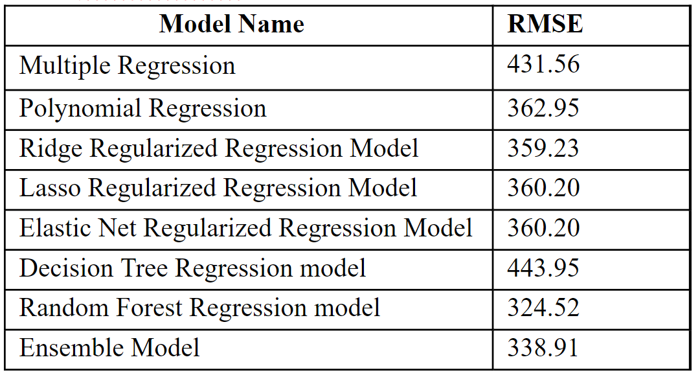
RMSE SUMMARY (Before Feature Elimination)

Slide 13
MODELS POST FEATURE ELIMINATION
Using backward elimination least significant features (p-value < 0.05) were removed from the transformed dataset.
Dataset was split into 70-30 train-test using train-test-split.
Used new train and test dataset for implementing linear regression, polynomial regression, regularized regression (ridge, lasso, elastic-net), decision tree, and random forest models.

Slide 14
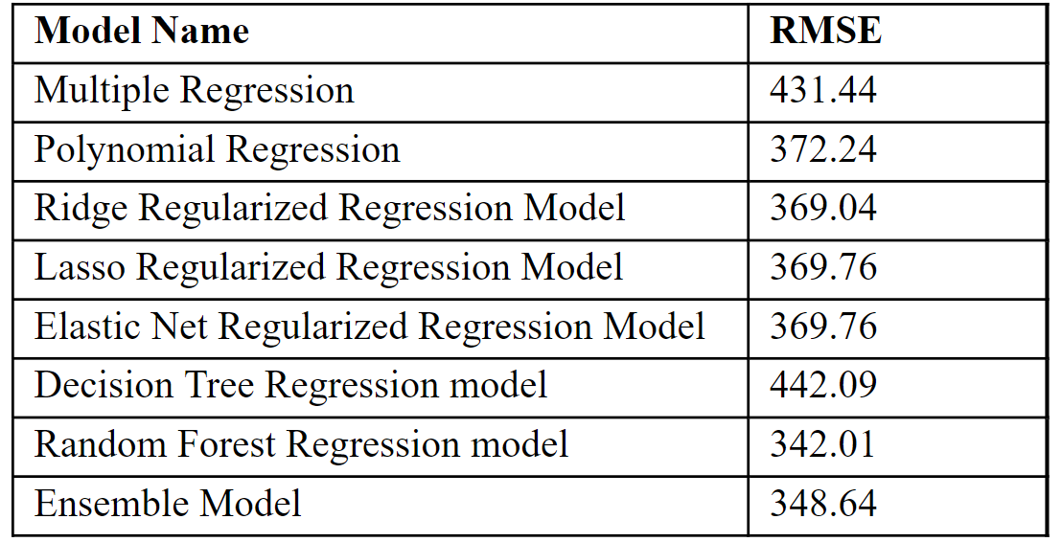
RMSE SUMMARY POST FEATURE ELIMINATION

Slide 15
FEATURE EXTRACTION
Principal Component Analysis (PCA)
The study set n_components at 13 for training the linear regression model. New X_train_pc and X_test_pc was created using the X_train_sig and X_test_sig.
Linear regression model was fit to X_train_pc and y_train_sig.
The RMSE for this linear regression model was 432.02.
Kernel Principal Component Analysis (RBF kernel)
The study set n_components at 14 for prediction. New X_train_pc and X_test_pc was created using the X_train_sig and X_test_sig.
Linear regression model was fit to X_train_pc and y_train_sig.
The RMSE for these new features linear regression model was 444.71.

Slide 16
BEST FIT MODEL
Root Mean Square Error was compared for models from both pre and post feature
elimination phases.
The lowest RMSE value of 325.52 was observed with random forest regression model on the raw cleaned dataset (pre feature elimination).
This model was further used to create final predictions on the number of bikes rented, as well as to explain certain hypothesis questions.

Slide 17
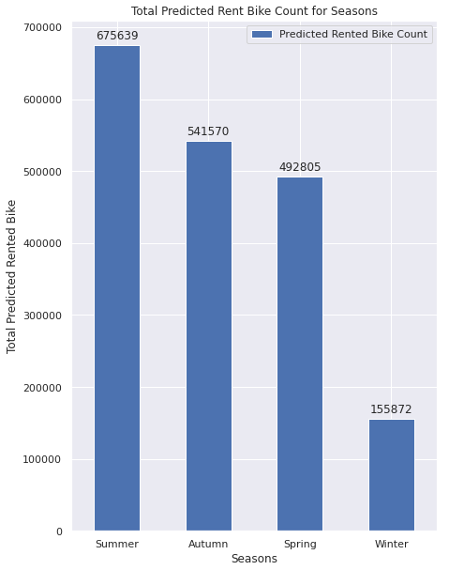
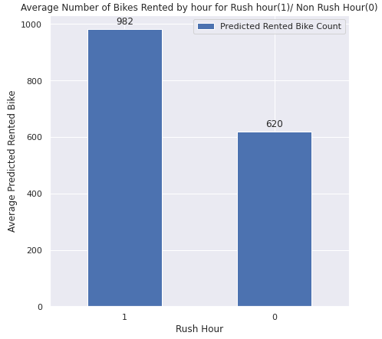
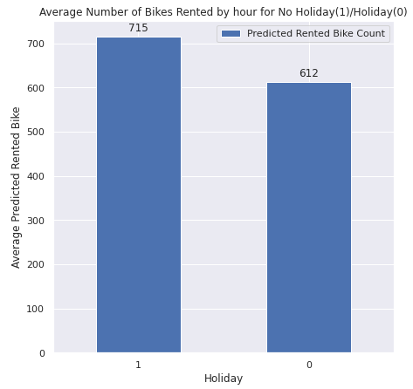
Summer season has most bike rentals.
HYPOTHESIS RESULTS
Rush hour has most bike rentals.
No holiday days have most bike rentals.

Slide 18
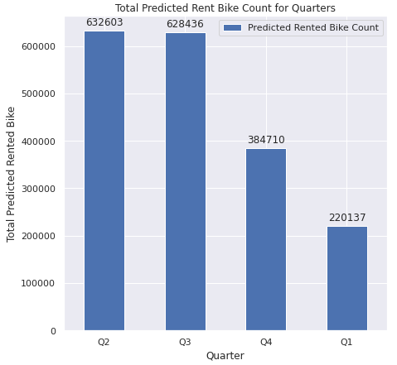
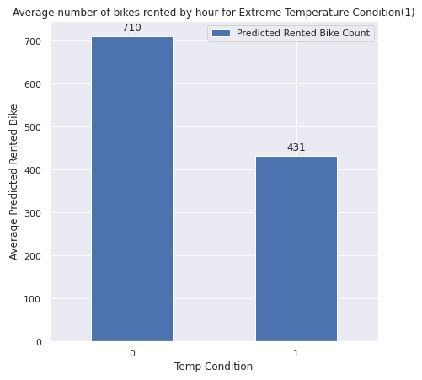
HYPOTHESIS RESULTS
Number of bikes rented in each quarter.
Extreme temperature led to low bike rentals.

Slide 19
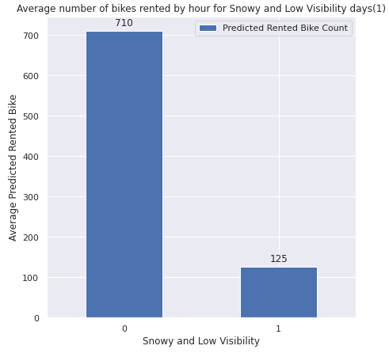
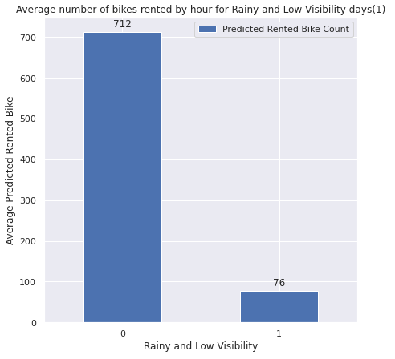
HYPOTHESIS RESULTS
Rainy days with low visibility led to low bike rentals.
Snowy day with low visibility led to least bike rentals.

Slide 20
CONCLUSION
As per the results people in Seoul, mostly rented bikes during no holiday and rush hour time as they could be renting bikes for daily commute.
Also, weather conditions plays pivotal role, as summer and spring had the most bike rentals.
People tend to rent most bikes when the temperature is favorable.
Conclusions can be used for planning purposes.
To add more bike stations to the city in the future.
To make current stations have adequate bikes to support the demand of rental bikes.

